Slide 1
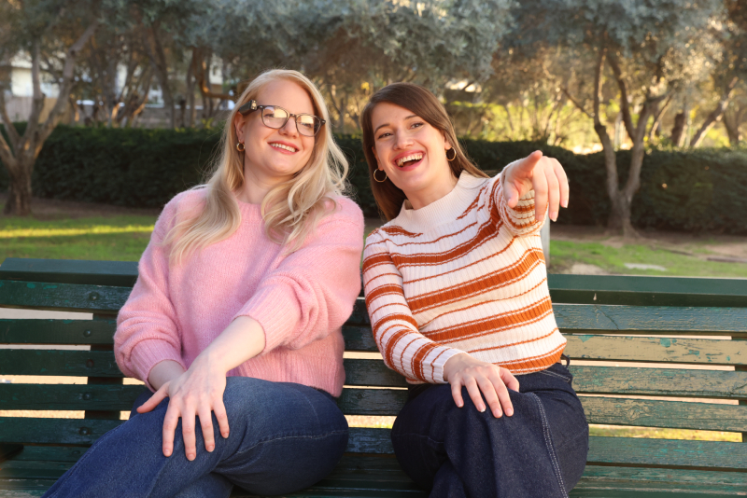
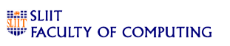
IoT Smart Glasses and Mobile App - Real-Time Assistance Using TinyML and Edge AI
Progress Presentation 01
R25-012

Slide 2

Introduction
According to the World Health Organization (WHO), there are 285 million physically impaired individuals worldwide, including 39 million blind people
Physically impaired individuals face significant difficulties in navigating unfamiliar environments, accessing written text, and recognizing known people, which can limit their independence and quality of life.
Advances in IOT (Internet of things), TinyML (Tiny machine learning) and Edge AI offer the potential to create wearable, real-time assistance tools tailored to address these challenges.

Slide 3

Research Question
Technical Performance & Optimization
How does TinyML model compression impact the accuracy-latency-trade-off in real-time inference on resource-constrained IOT smart glasses?
What are the limitations of current Edge AI hardware
User Experience & Practical Applications
How does real-time processing on smart glasses enhance user accessibility (e.g., visually impaired users) compared to cloud-dependent systems?
What methods can be implemented to ensure accurate and efficient facial recognition to identify known people in real time?

Slide 4







Objectives
Main Objective:
To design and develop IOT-enabled smart glasses and a mobile app that provide real-time assistance to physically impaired individuals using TinyML and Edge AI, improving their navigation, reading, and social interaction capabilities
Sub Objectives
Navigation Assistance
Reading Assistance
Identifying known people
Integration with mobile application
Optimizing through TinyML and EdgeAI
Evaluating and testing

Slide 5
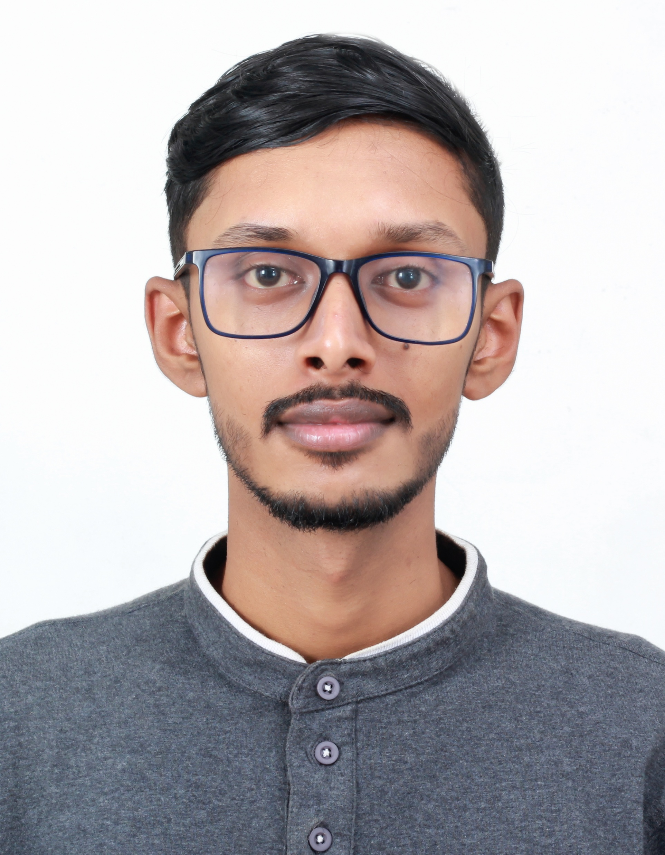
IT21820946 | Rayan Weragala
BSc (Hons) Degree in Information Technology (specialization in Information Technology)

Slide 6
Component 01 : Real-Time Facial Recognition for Identifying Known Individuals with Personalized Voice Feedback.
Introduction
In Sri Lanka, visually impaired individuals face significant challenges in identifying and recognizing people during social interactions, limiting their independence and social confidence. Current assistive technologies are often too expensive or inaccessible for many in developing countries.
Key features include:
Lightweight Models: Optimized facial recognition using TinyML and edge AI for real-time processing.
Personalized Voice Feedback: Provides names and context-specific details via headphones or bone-conduction speakers.
Low-Cost Design: Built with economical hardware to ensure affordability and accessibility.

Slide 7



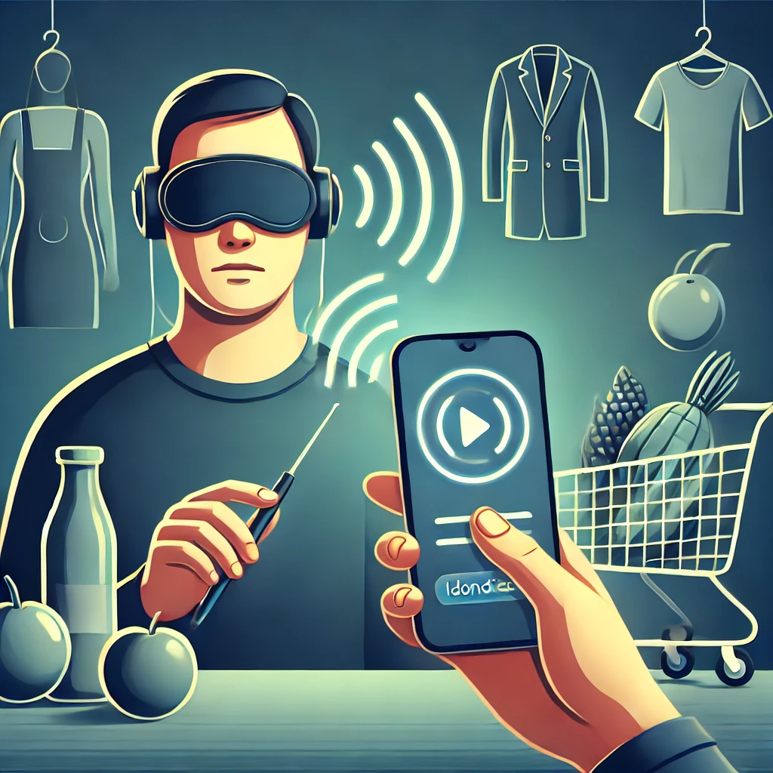
So far I have completed...
To develop a facial recognition system using TinyML and Edge AI that allows visually impaired individuals to add and store known faces as "friends" for future recognition
Completion up-to date – 40 %
Completed task – Built a model that can identify faces from camera frame. And showing there name and current facial expression

Slide 8
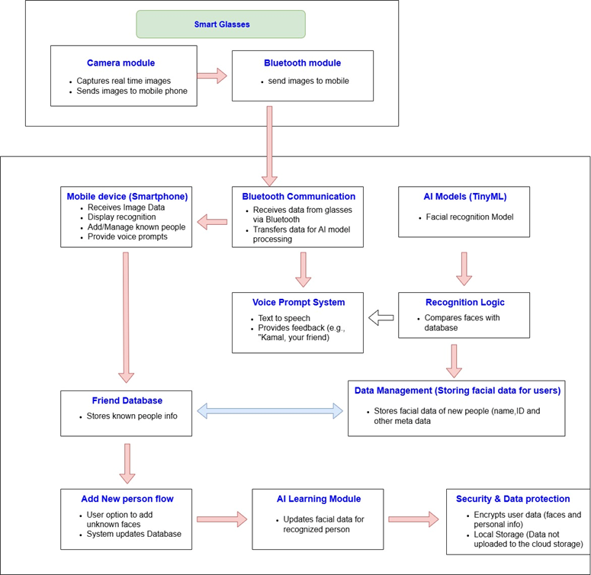

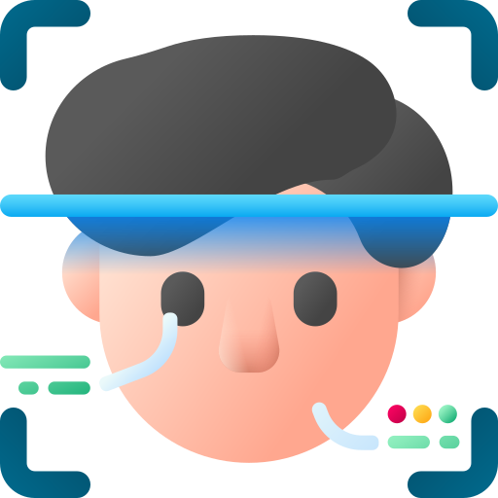
Objectives

Slide 9
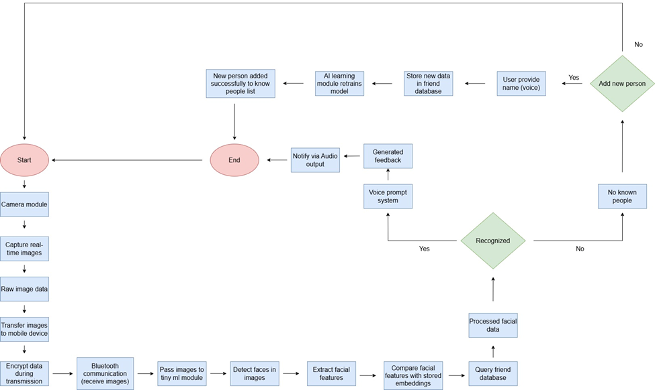
Component Diagram

Slide 10
Proposed Improvements
Improve Face Recognition Accuracy Enhance the underlying recognition algorithm to achieve higher precision and reliability across diverse facial features, angles, and environmental conditions.
Automate the Entire Workflow Streamline and automate all stages of the face detection and recognition process, minimizing the need for manual intervention.
Integrate Voice-Based Output Implement voice feedback functionality to announce recognition results audibly, enhancing accessibility and real-time interaction.
Support Custom Training with Known Individuals Enable users to upload images of known individuals, allowing the system to learn and recognize them in future interactions through a personalized training mechanism.
Deploy on Edge Devices Using Microprocessors (Edge AI / TinyML) Integrate and optimize the complete system for deployment on microprocessor-based edge devices, leveraging Edge AI or TinyML techniques to ensure low-latency processing, reduced power consumption, and on-device intelligence without dependence on cloud infrastructure.
Create Mobile application user interface

Slide 11
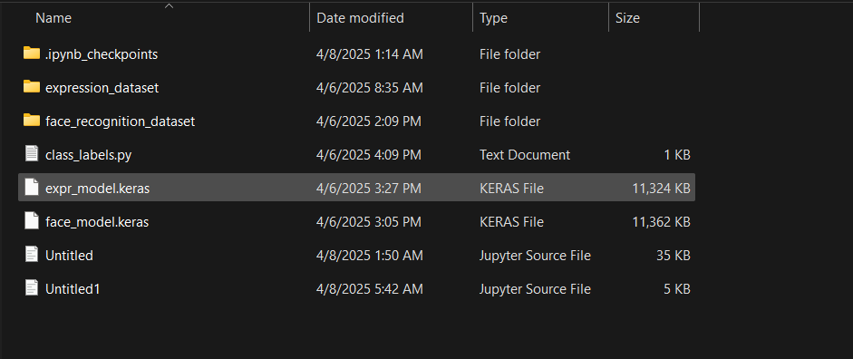
Evidence of completion

Slide 12
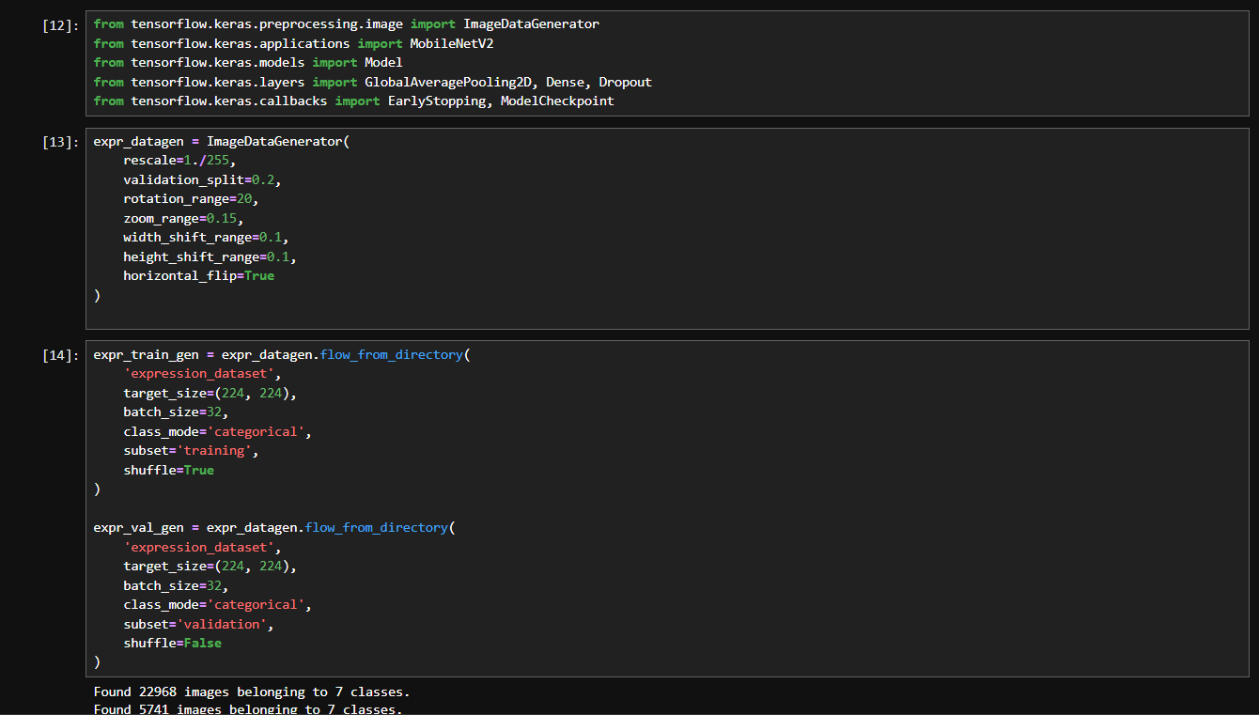

Slide 13
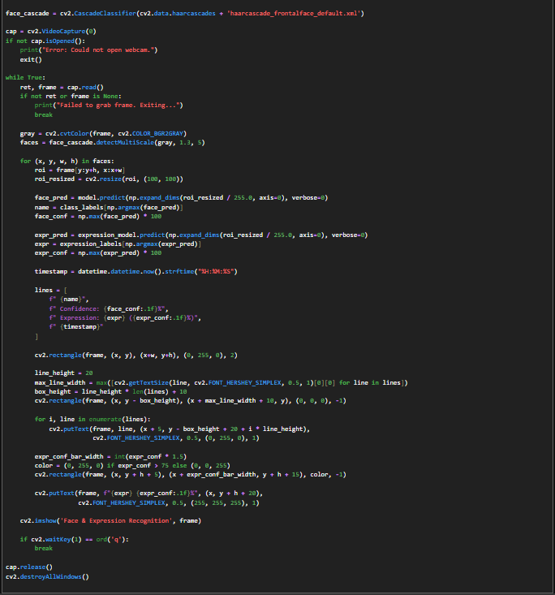

Slide 14
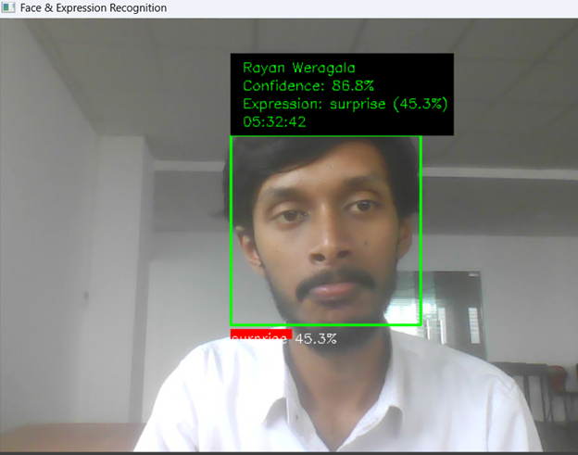
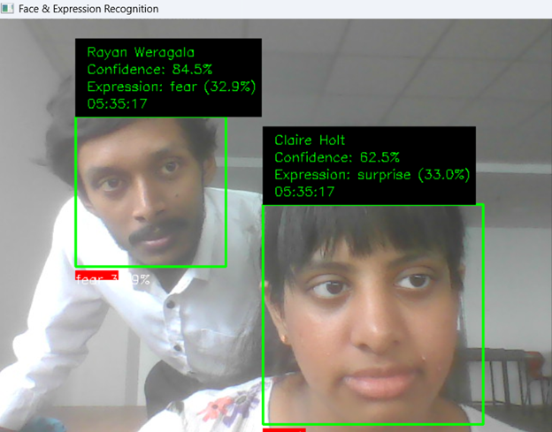
Demonstration Output

Slide 15

Component Specific Requirements
Functional Requirements
Face Detection
The system must detect human faces in the camera’s field of view in real time
The detection process should work efficiently under various lightning conditions.(e.g., indoors, outdoors, dim light)
Non-unctional Requirements
Performance
Scalability
Portability
Affordability
Reliability
Usability
Energy Efficiency
Security

Slide 16
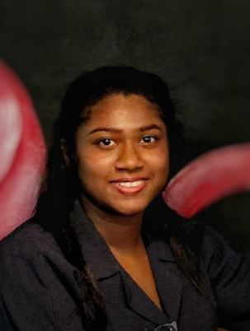
IT21826740 | K.D. Dilini
BSc (Hons) Degree in Information Technology (specialization in Information Technology)

Slide 17
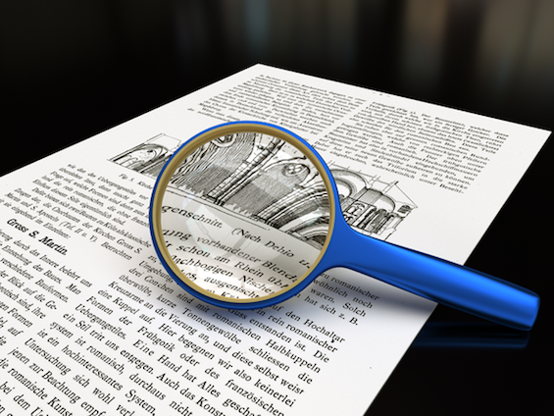
Sinhala Text Recognition and Voice Feedback for Visually Impaired - Optical Character Recognition (OCR)

Slide 18
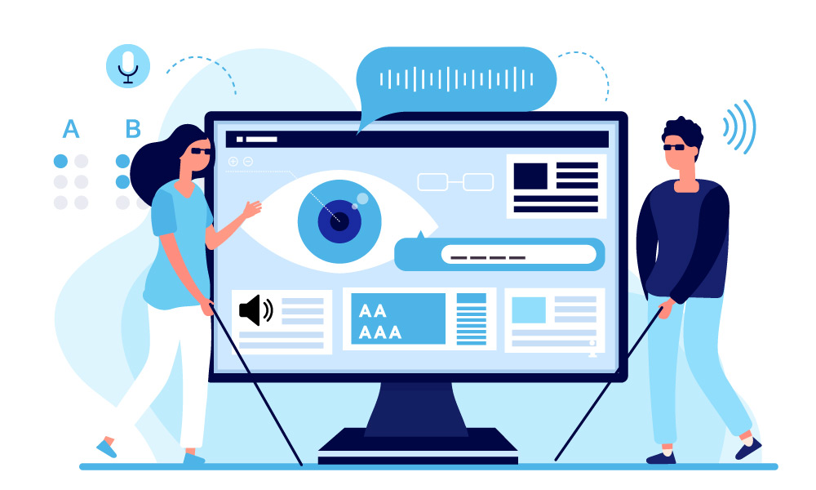
Introduction
I have successfully completed training a model for document detection, including printed documents. I developed a custom dataset comprising 18,000 samples across six diffrentg classes. The model is capable of detecting both Sinhala and English text with high accuracy. As well as I have used tiny ML and Edge ai for the development.
IT21826740 | K.D.Dilini | R25-012

Slide 19

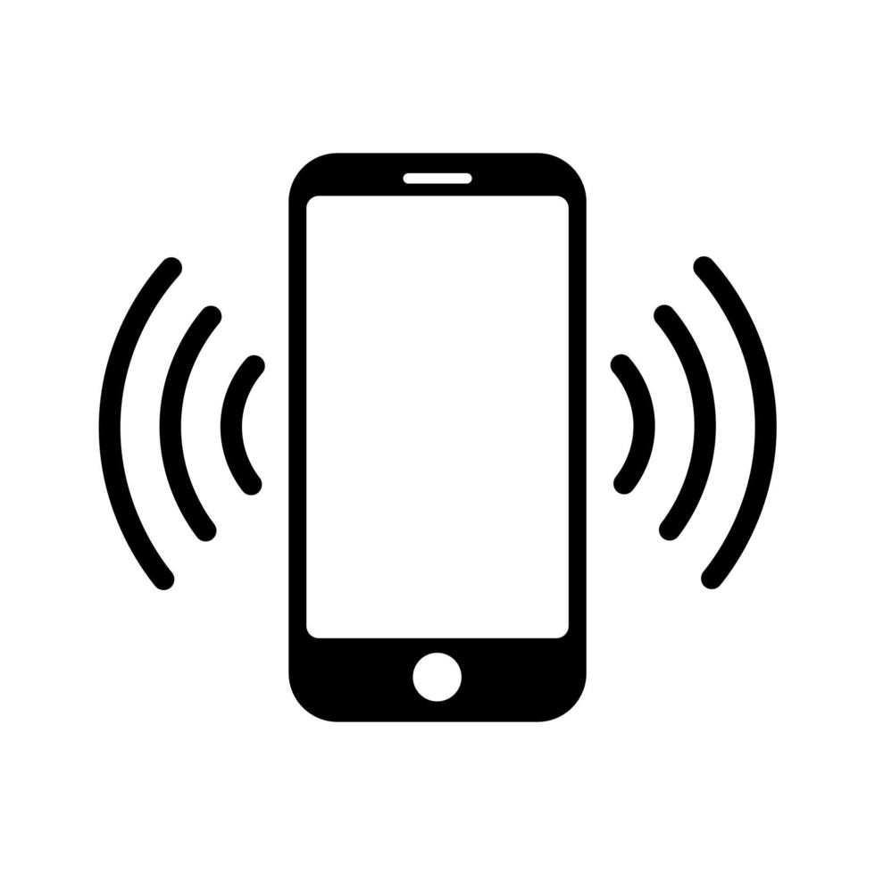




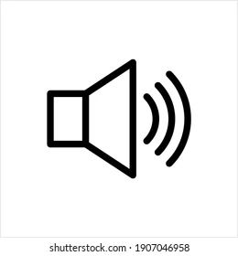




System Diagram
Visually impaired person with Sinhala textbook
The smart glasses’ camera continuously captures images of the surrounding environment or the text in focus.
The captured image is preprocessed (e.g., cropping, removing noise) to focus on the text for recognition.
User find correct position through the voice command
Capture the texts as image
The generated audio is played through a speaker or headphones, enabling the user to hear the text.
The recognized text is converted into an audio format using a Text-to-Speech (TTS) module.
extracts the text from the captured image
Optical Character Recognition (OCR) identifies
TinyML algorithms process the text locally on the device for efficiency.
IT21826740 | K.D.Dilini | R25-012​

Slide 20
First Component Process OCR Component
Purpose:
Extract text from images in English and Sinhala languages with Pytessract.
How it works:
Image Preprocessing:
Converts images to grayscale.
Applies adaptive thresholding and noise removal (median blur).
Text Extraction:
Uses Tesseract OCR to process preprocessed images.
Supports language-specific extraction (e.g., "eng" for English, "sin" for Sinhala).
Interactive Mode:
Categorizes images by likely language.
Provides a menu-driven interface for user selection.
IT21826740 | K.D.Dilini | R25-012​

Slide 21
Technologies and Features
Technologies Used
Python: Core programming language.
OpenCV (cv2): Image preprocessing (grayscale, thresholding, noise removal).
Pytesseract: OCR engine for text extraction.
PIL (Pillow): Image file handling.
NumPy: Array operations for image data.
Matplotlib: Optional visualization
Model
Tesseract OCR -
Open-source OCR engine with pre-trained language models for English and Sinhala
IT21826740 | K.D.Dilini | R25-012

Slide 22
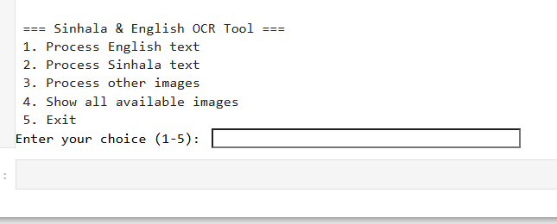
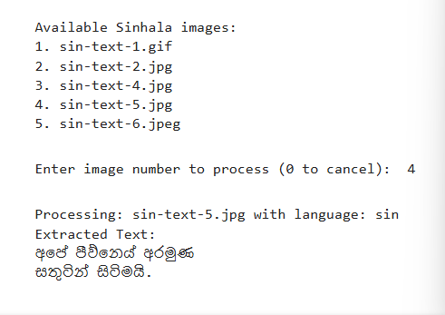
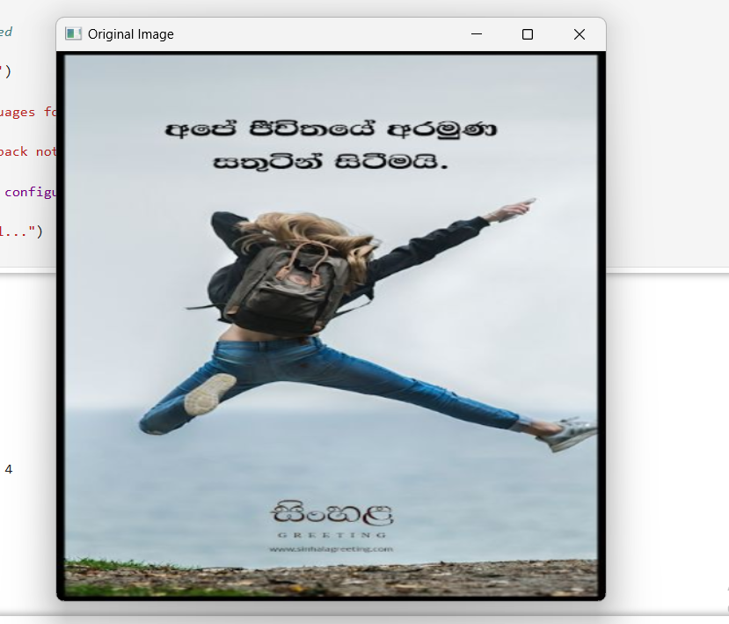
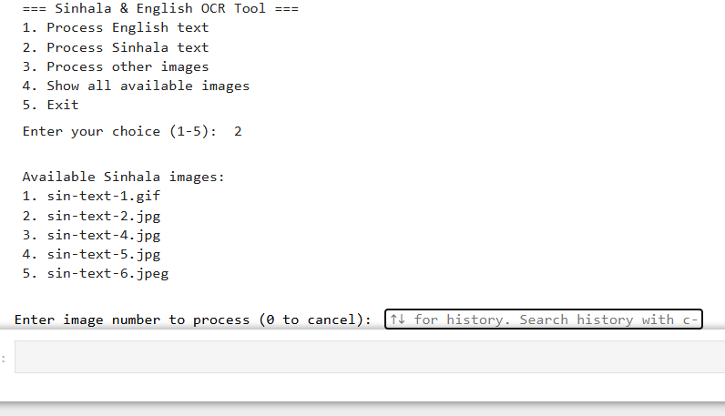
Work flow
Choose Option → Preprocess → Extract text → Display results → Show image.
IT21826740 | K.D.Dilini | R25-012

Slide 23
Second Component Process Sinhala Document Classifier
Purpose :
Classify Sinhala document images into types (e.g., exam, form, story) with Sinhala identifications.
How it works:
1. Image Preprocessing:
- Loads and resizes images to 128x128 pixels.
- Normalizes pixel values for model input.
2. Classification:
- Uses a TensorFlow Lite model to predict document type.
- Maps predictions to labels and Sinhala translations.
3. User Interaction:
- Provides a Jupyter widget interface for image upload/path input and prediction.
Model :
- TensorFlow Lite Model: Custom-trained model (`sinhala_document_identifier_model.tflite`) for document type classification.
IT21826740 | K.D.Dilini | R25-012​

Slide 24
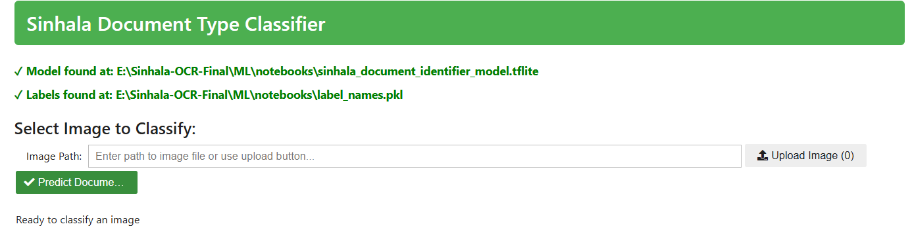
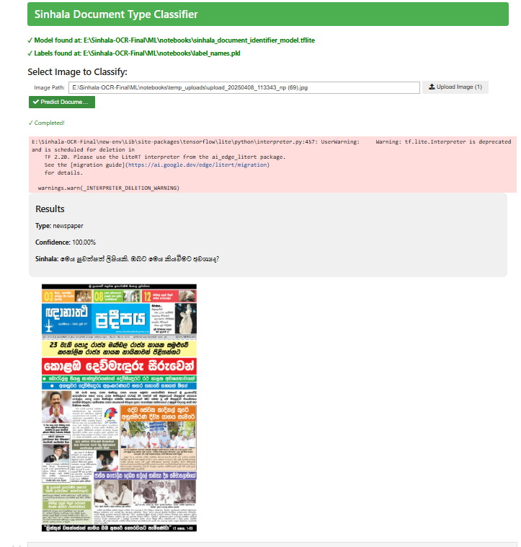
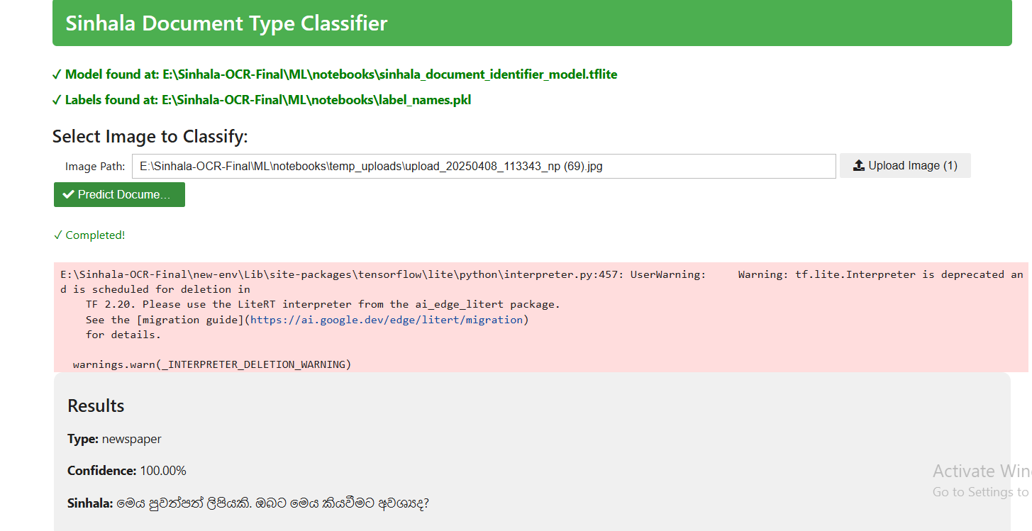
Work flow
Input image → Preprocess → Predict type → Display result with confidence and Sinhala text.
IT21826740 | K.D.Dilini | R25-012

Slide 25
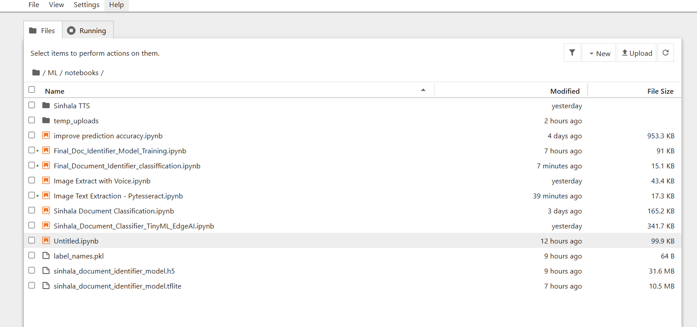
Evidence of completion

Slide 26
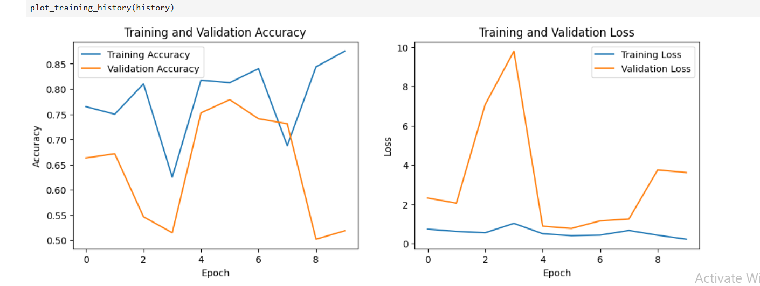
Evidence of completion

Slide 27
Work Breakdown Structure
Optical Character Recognition (OCR)
Initiation
Planning
Design
Implementation And Testing
Closeout
Create a Project charter
Requirement Analysis
System Architecture
Setup the developing environment
Final presentation
Create a Project proposal
Literature Review
Wireframe design
Host the mobile application
Identify the inputs
Feasibility Study
Design Interfaces
Research paper
Identify the inputs
Implement mobile application
Testing
IT21826740 | K.D.Dilini | R25-012​

Slide 28
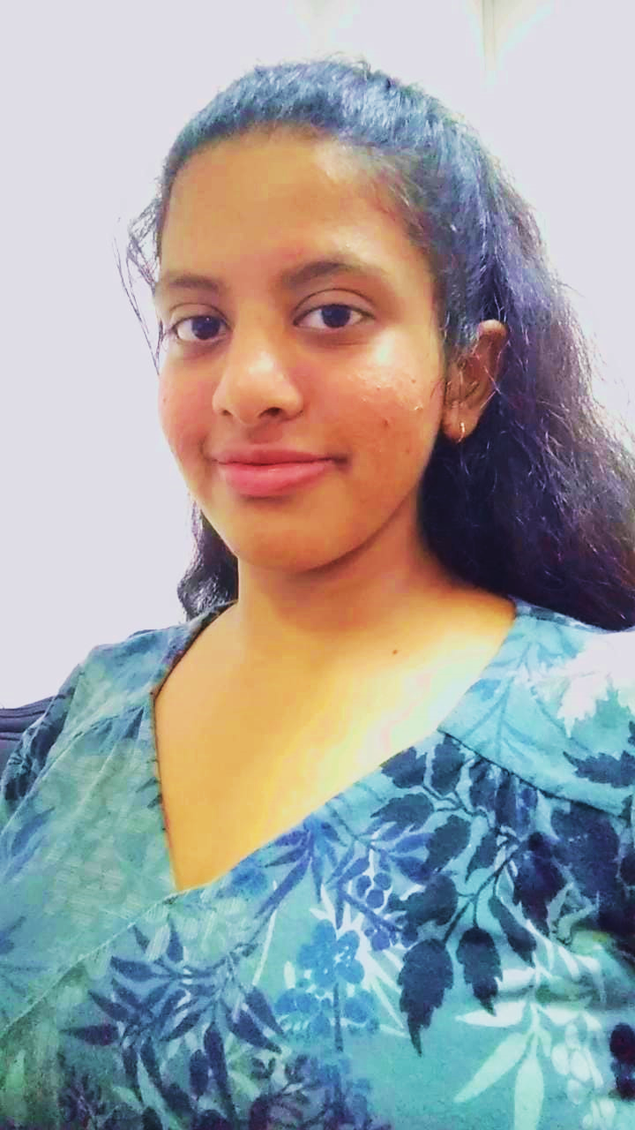
IT21823220| VITHANAGE H.P
BSc (Hons) Degree in Information Technology (specialization in Information Technology)

Slide 29
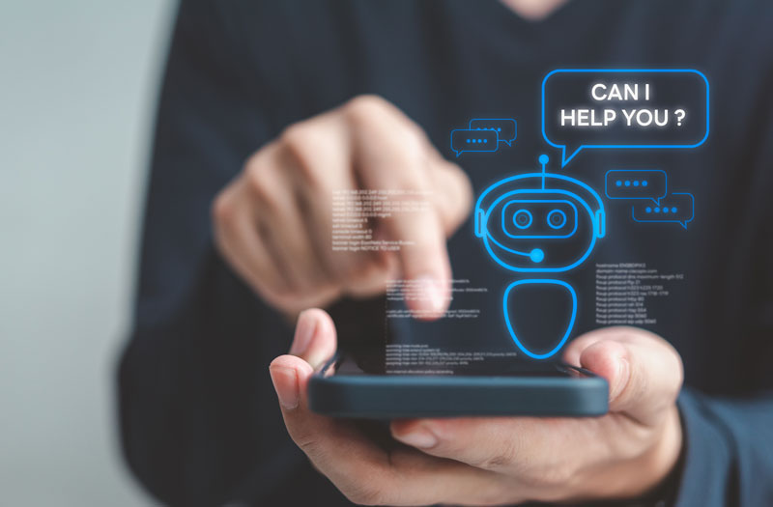
Component 03 :Voice-Driven Interaction Module
IT21823220| Vithanage H.P | R25-012

Slide 30
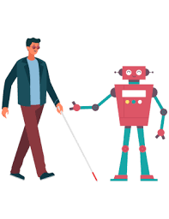
Introduction
This system enables voice-controlled environmental awareness and document navigation through IoT glasses. Using offline AI, it detects objects, reads text via OCR, and alerts users to page transitions, providing real-time audio feedback for visually impaired assistance
IT21823220| Vithanage H.P | R25-012​

Slide 31
So Far I have completed...
✔️ Added Flask API endpoints for object/text detection ✔️ Integrated OCR with page-end detection logic ✔️ Built React UI for voice command controls ✔️ Configured YOLOv8 for real-time object listing ✔️ Set up virtual environment with critical dependencies
IT21823220| Vithanage H.P | R25-012​

Slide 32
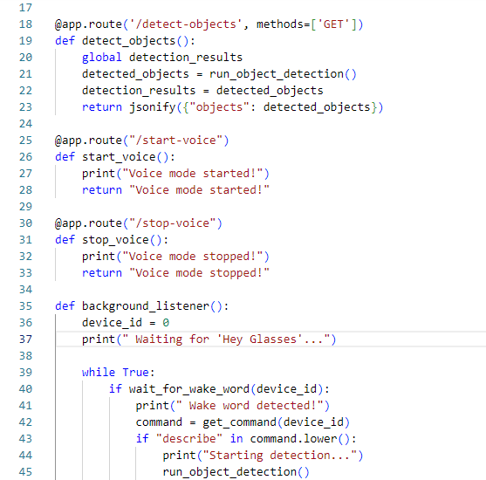
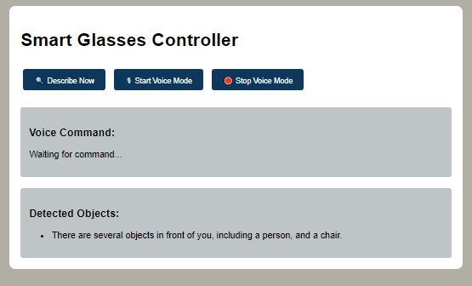
UI for easier Access
Code Snipet of the main.py

Slide 33
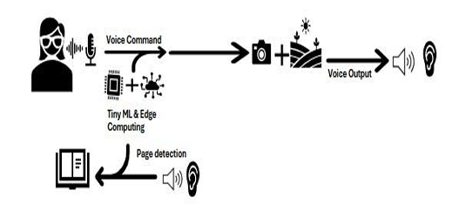
System Diagram
IT21823220| Vithanage H.P | R25-012​

Slide 34
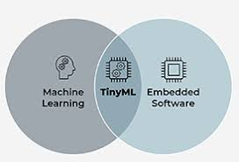
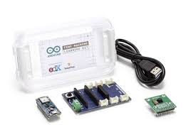
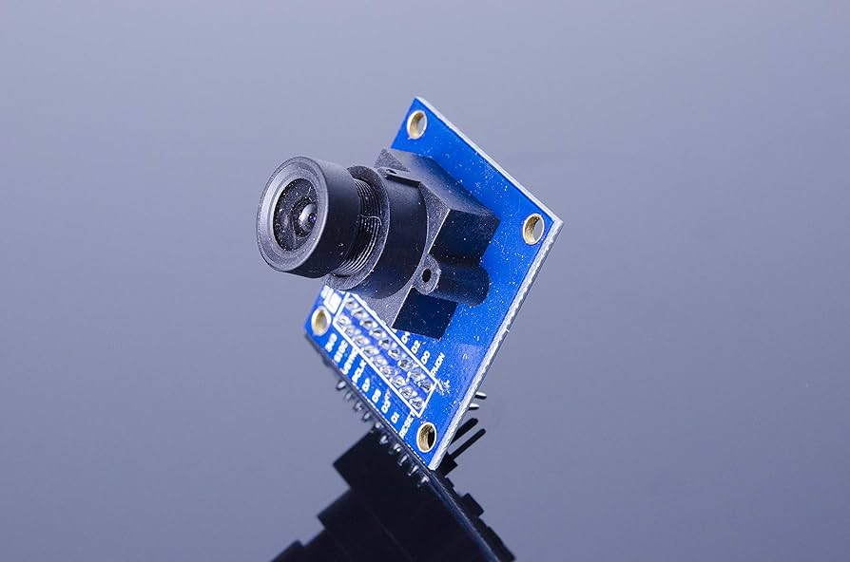

Technologies &Tools
Voice Processing: Python, TensorFlow Lite
Vision: OpenCV, YOLOv8, Tesseract OCR
Integration: Flask API, React Frontend
IT21823220| Vithanage H.P | R25-012​

Slide 35
Proposed Improvements
The system shall support Sinhala and other languages for voice output.
The system shall adapt to regional dialects and pronunciation nuances for better usability.
The system shall detect the end of a page using visual cues (e.g., blank space, page borders) or user input (e.g., swiping gestures).
The system shall notify the user through voice prompts when a page ends.
IT21823220| Vithanage H.P | R25-012​

Slide 36

IT21821486 | Punchihewa A.S.G
BSc (Hons) Degree in Information Technology (specialization in Information Technology)

Slide 37
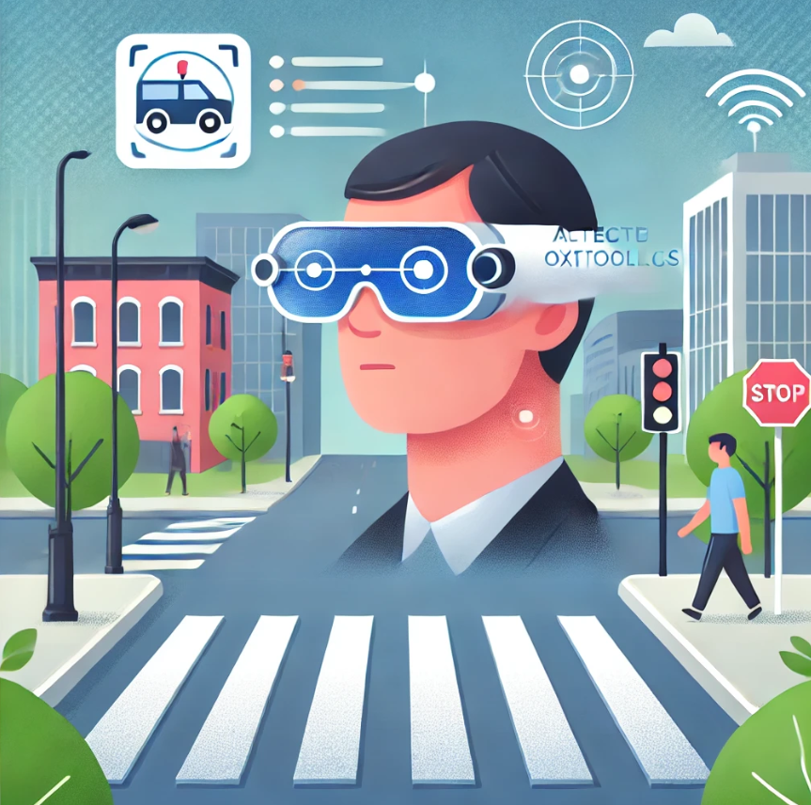
Introduction
Real-time navigation assistance is essential for mobility in dynamic environments, particularly for visually impaired users or in crowded areas. Traditional cloud-based systems often face challenges such as latency, privacy concerns, and dependency on external infrastructure. This project presents a fully on-device solution using Edge AI and TinyML to enable low-latency obstacle detection and guidance. At its core, the system features a microphone that captures voice commands, allowing users to interact naturally. The system interprets these commands and provides real-time, context-aware audio feedback. Combined with ultrasonic sensors and lightweight, optimized algorithms for wearables, it delivers efficient, responsive navigation support while maintaining low power consumption
IT21821486| Punchihewa A.S.G | R25-012

Slide 38
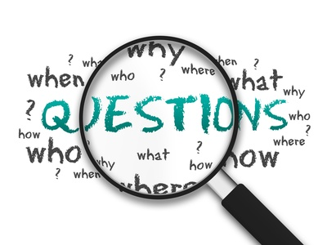
So far I have Completed
Main Objective – Build a lightweight model to be deployed on edge devices and use Tinyml to run with minimum computing power
Completion upto date – 45%
Completed task - Built a model to identify Sinhala characters from a audio clip
IT218286 | Punchihewa A.S.G| R25-012

Slide 39





System Diagram
The smart glasses’ camera continuously captures images of the surrounding environment
+
Visually impaired person
Sensors in the devices capture obstacle distance, shape, and movement data.
Raw sensor data is filtered and normalized to remove noise/errors.
Lightweight AI models process data to classify obstacles and assess risk and determine distance
Alerts the user via audio or haptic vibration
Prioritizes obstacles and selects feedback mode (audio/haptic).
IT218286 | Punchihewa A.S.G| R25-012

Slide 40

Proposed Improvements
•Increase Accuracy of the speech recognition
•Build the character identification model
•Automate all the process
•Make the model lightweight
IT218286 | Punchihewa A.S.G| R25-012​

Slide 41
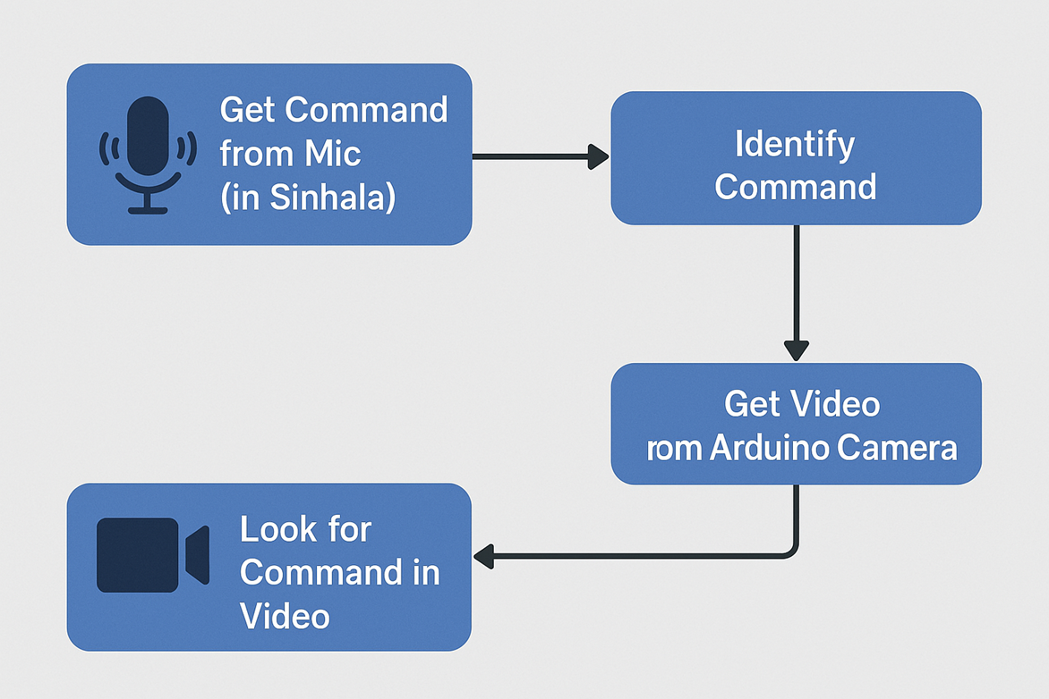
OpenAI whisper multi language model fine tuned for Sinhala Language
Dataset – Publicly Available dataset of Sinhala audio clips on kaggle by Keshan Sodimana (Sinhala tts dataset)
IT218286 | Punchihewa A.S.G| R25-012

Slide 42
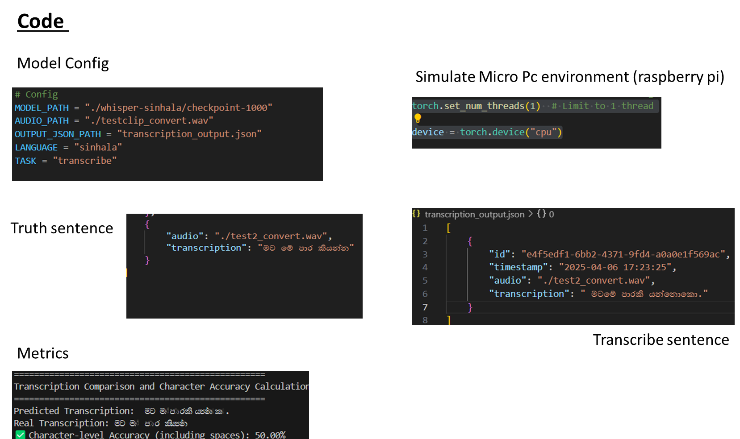
IT218286 | Punchihewa A.S.G| R25-012

Slide 43
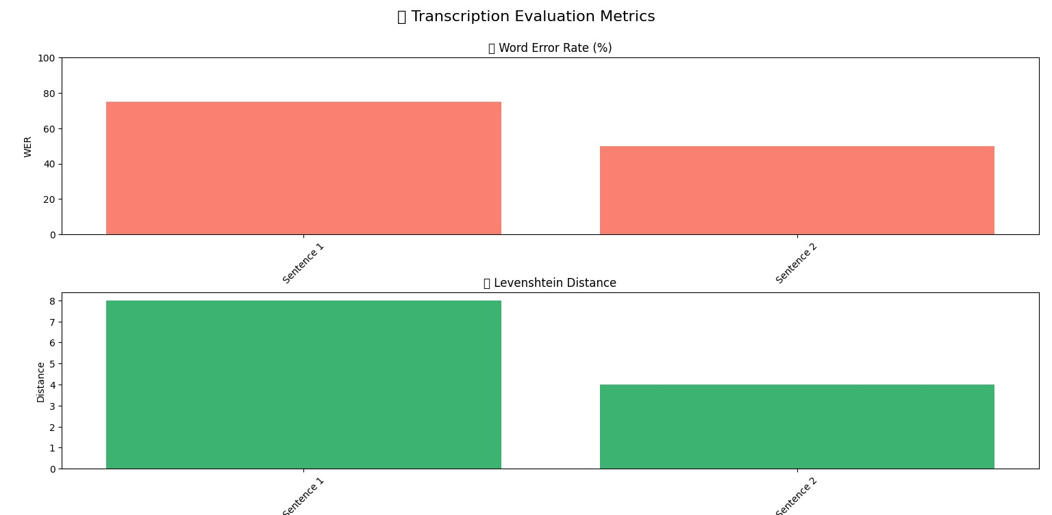

Slide 44
Proposed Improvements
Increase Accuracy of the speech recognition
Build the sinhala character identification model
Automate all the process
Make the model more lightweight
Make an interface for audio to text
IT218286 | Punchihewa A.S.G| R25-012​

Slide 45
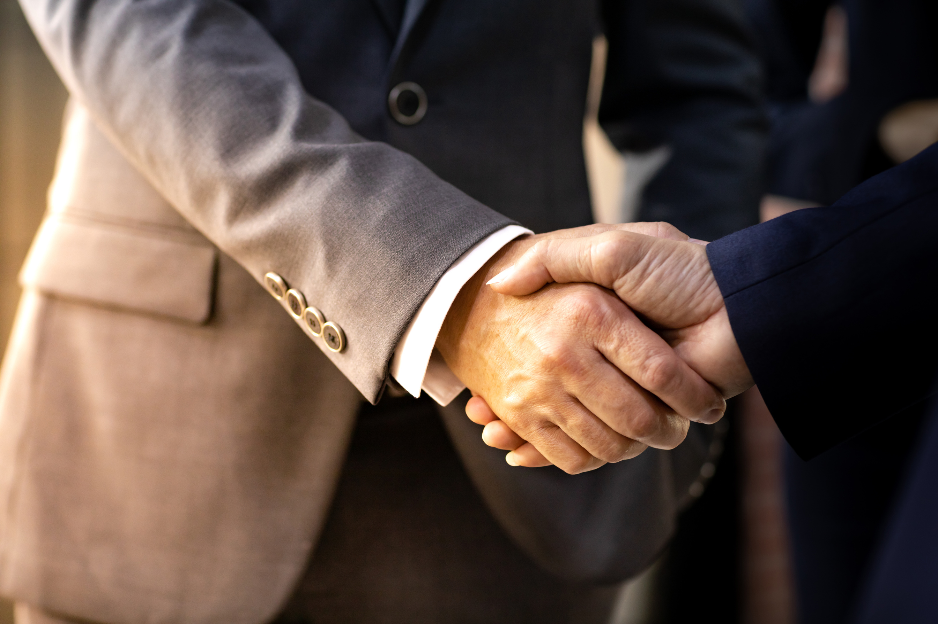


Thank You

